Slide 1
Increasing diversity in technology

Slide 2
Founded in September 2017, with the mission:
The purpose of the Association, a non- profit organization, is:
a) organizing educational, tech-related and networking events with the goal of women empowerment;
b) increasing the number of women working in the tech sector via promotion of STEM-related fields among its target group of individuals, providing role models, and creating a safe and supportive environment fostering collaborations, entrepreneurship and innovation;
c) promoting talented women in tech, and collaborating with companies/ universities/organizations/other legal entities, which are invested in gender diversity.
Notes:
Say what is the mission

Slide 3
2018 Events
21 January: Improve your CV, Interview & Negotiation Skills
27 January: Machine Learning for News: Theory, Application & Visualization & AMLD
07 March: Design Thinking (Basel)
17 March: Webinar Moving Towards What you Want
07 April: Python Workshop at IWD’18
08 April: Intro to Blockchain, Cryptocurrencies & Coding Smart Contracts
26 May: Hack’n’Lead Prep-Event
13? June: Intro to Blockchain @ Trust Square
16 & 17 June: Hack’n’Lead
07 Nov: Machine Learning & NLP joint meetup
09 Dec: Mobile Development with Flutter
Our specialty: WORKSHOPS!
Notes:
Say some keywords about workshops we did in 2018

Slide 4
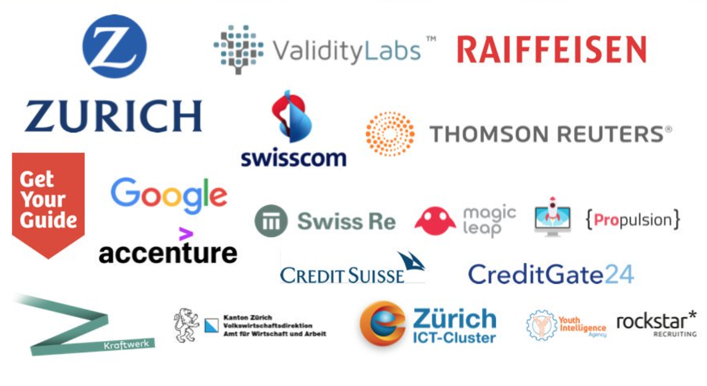

2018 Companies we’ve worked with

Slide 5







2018 Communities we’ve worked with

Slide 6
Hack’n’Lead: hackathon by women for women (and men)

Slide 7
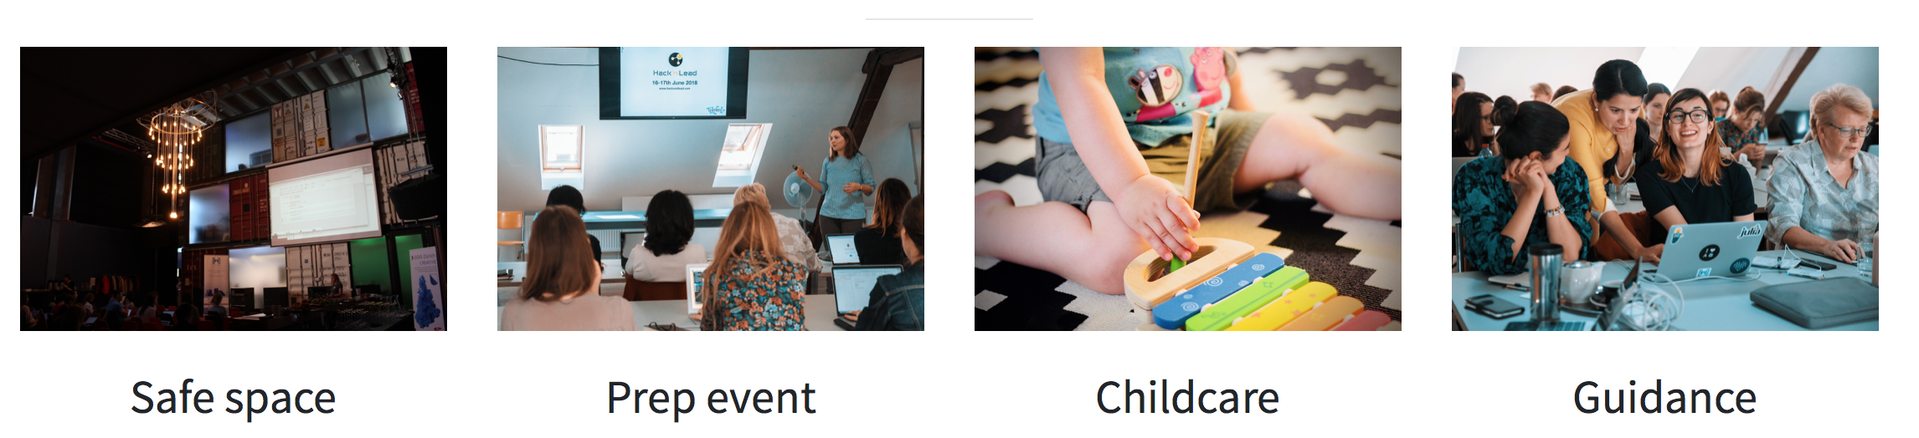
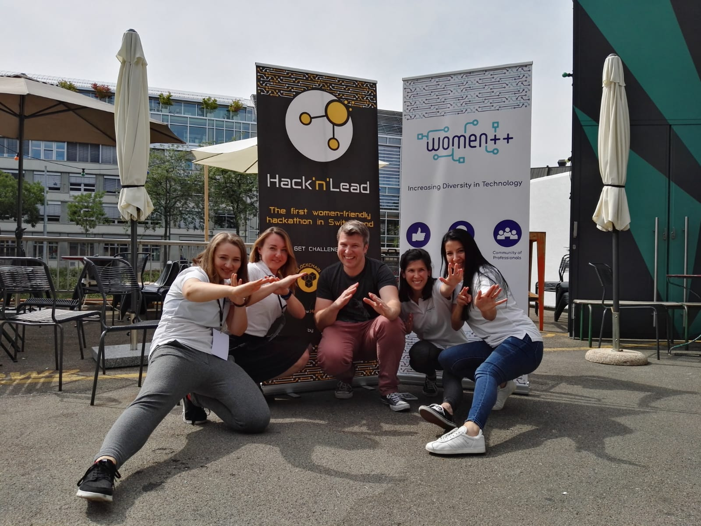
About Hack’n’Lead
Notes:
We did a hackathon covered in Swiss media outlets with childcare etc. and we’re doing in again in 2019

Slide 8
Hack’n’Lead 2018 - the first women-friendly hackathon in Switzerland
Notes:
Some impressions from Kraftwerk in Zurich, we’re doing HacknLead again!

Slide 9
Hack’n’Lead 2.0 - autumn 2019
Call for Sponsors!

Slide 10
We’re looking for a new board member
Seats in 2019:
Aleksandra Sokolowska (Zug),
Diana Herrle (Zurich),
Maelle Baud (Lausanne),
Marina Petrova (Zurich),
You?

Slide 11
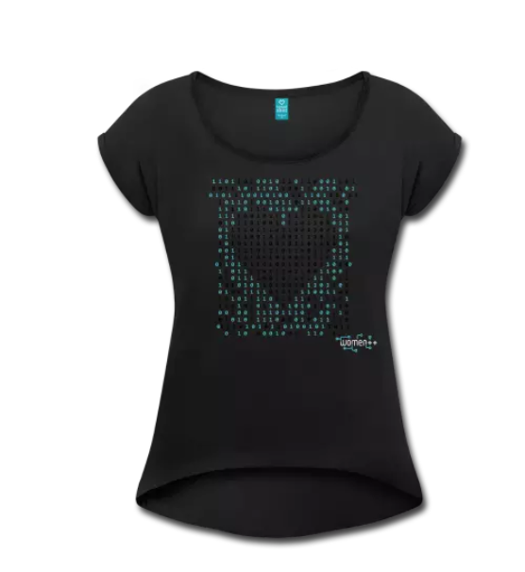

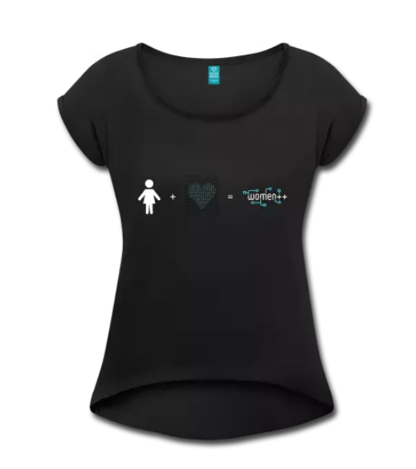
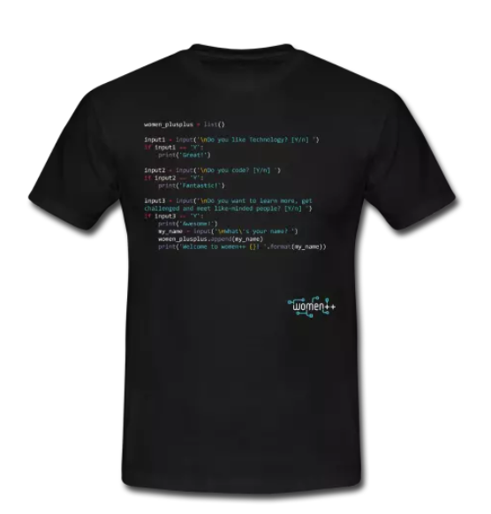
Shop of women++
https://shop.spreadshirt.ch/women-plus-plus

Slide 12
womenplusplus@gmail.com
womenplusplus.ch

